Slide 1


Social
Buzz

Slide 2


Today's agenda
Project recap
Problem
The Analytics team
Process
Insights
Summary

Slide 3

Social buzz is a fast growing technology company that emphasizes
content by keeping all users anonymous, only tracking user
reaction on every piece of content. Accenture has begun
a 3 month POC with them focusing on these tasks:
- An audit of their big data Practice.
- Recommendation for a successful IPO.
- An Analysis of their content categories that highlights
the top 5 categories with the largest aggregate popularity.
Project Recap

Slide 4


Problem
Over a 100000 posts per day
36,500,000 pieces of content per year!
How to manage it and uncover insights from these data when there is so much?
An analysis of to find social buzz ‘s top 5 most popular content category

Slide 5



{Myself}
Data Analyst
The Analytics team
Marcus Rompton
Senior Principle
Andrew Fleming
Chief Technical Architect

Slide 6
Data Understanding
Process
1
Data Cleaning
2
Data Modeling
3
Data Analysis
4
Uncover insights
5

Slide 7

Insights
16
UNIQUE
CATEGORIES
1879
REACTIONS TO
’ANIMALS’ POST
MAY
MONTH WITH
MOST POSTS

Slide 8
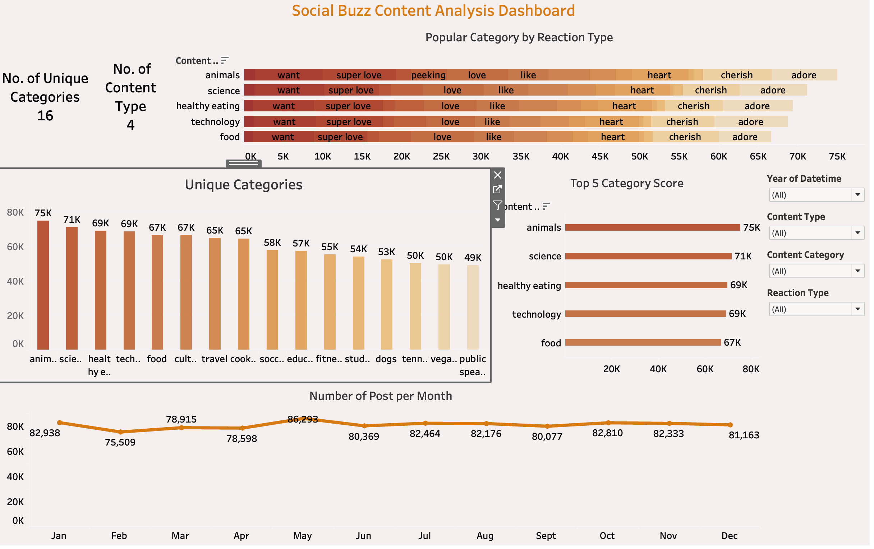

Slide 9
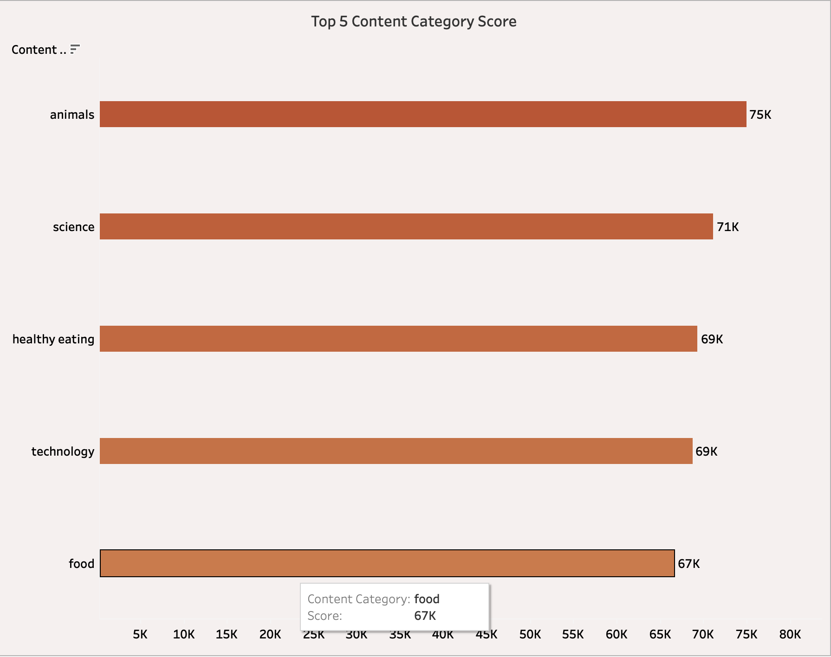

Slide 10
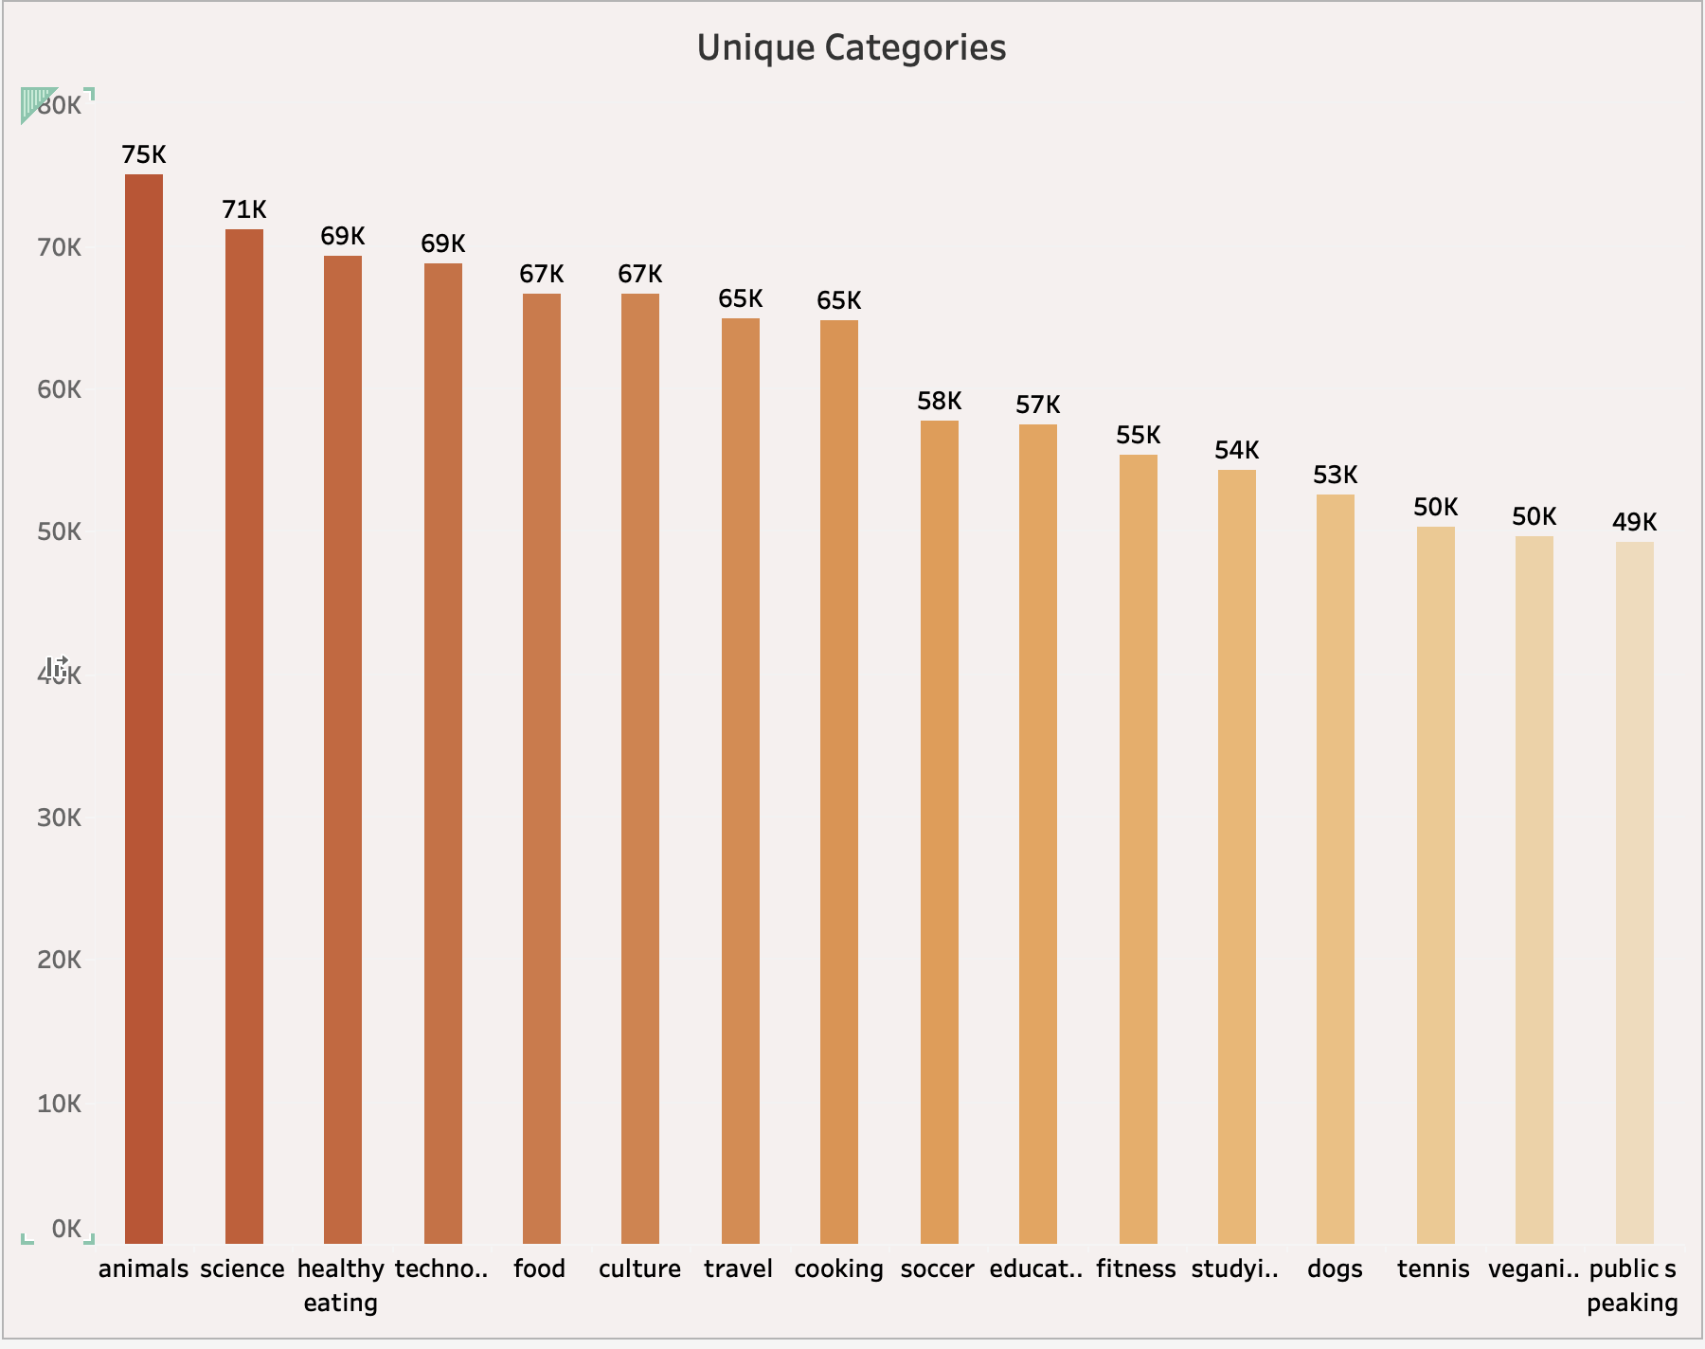

Slide 11
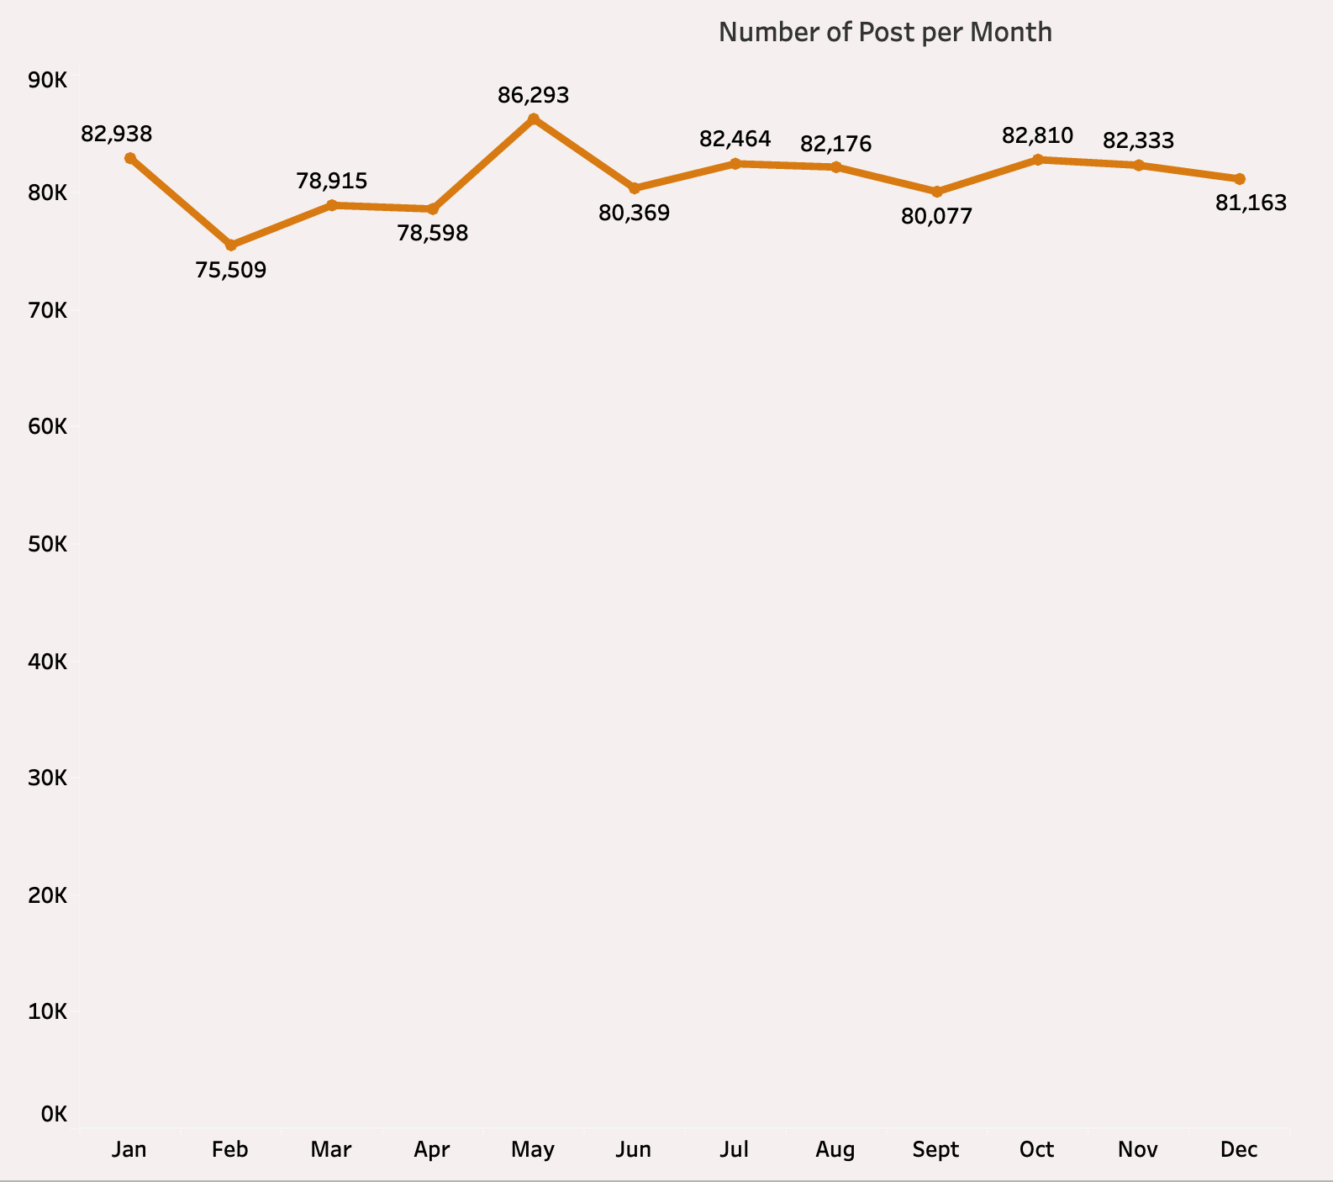

Slide 12
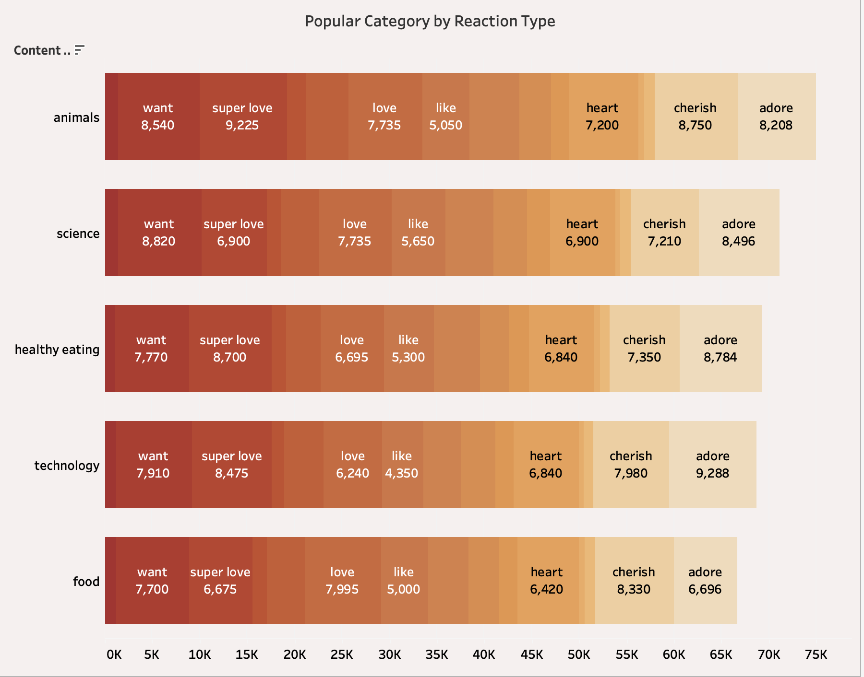

Slide 13

ANALYSIS
Animal and Science are the most popular
Content categories , showing that people love
“real-life” and “factual” content the most
INSIGHT
Food is a common theme within the top 5
Category with “healthy eating” ranking the
highest. This gives an indication of your user
base interests. You could use this insight to
create a campaign and work with healthy
eating brands to boost user engagement.
NEXT STEPS
This ad-hoc analysis is insightful, but it is
time to take this analysis into large scale
production for real-time understanding of
your business. We can show you how to do
this.
Summary

Slide 14

Thank you!
ANY QUESTIONS?

